Slide 1

Project Phoenix:
A Newspaper's Survival Guide: Data-Driven Strategies for the Digital Age
Presented to Newspaper Executives and Senior Stakeholders

Slide 2
THE DILEMMA & THE DIRECTION
Navigating the Digital Shift
The Challenge:
The Goal:
The newspaper industry is at a critical juncture. Declining print circulation and advertising revenue are eroding traditional business models. A strategic, data-driven transition to a sustainable digital model isn't just an option—it's essential for survival and future growth.
Our objective is to analyze internal data on sales, revenue, and digital readiness to identify critical trends. By segmenting markets and formulating a precise, data-driven strategy, we aim to facilitate a seamless and profitable transition from print to digital dominance.

Slide 3







OUR FOUNDATION
Leveraging Our Data Assets for Strategic Advantage
Our analysis is built on a comprehensive suite of internal datasets, providing a 360-degree view of our operations and market dynamics. These rich data sources empower us to make informed decisions and carve out a clear path forward in the digital landscape.
Ad Revenue Data
Print Sales Data
City Digital Readiness Metrics
Granular insights into advertising performance across all platforms.
Detailed records of circulation, subscriptions, and distribution.
Key indicators of digital adoption and infrastructure in our operating cities.
Digital Pilot Program Data
Supporting Dimension Tables
Performance metrics and user feedback from our initial digital initiatives.
Contextual data on city demographics, ad categories, and operational factors.

Slide 4
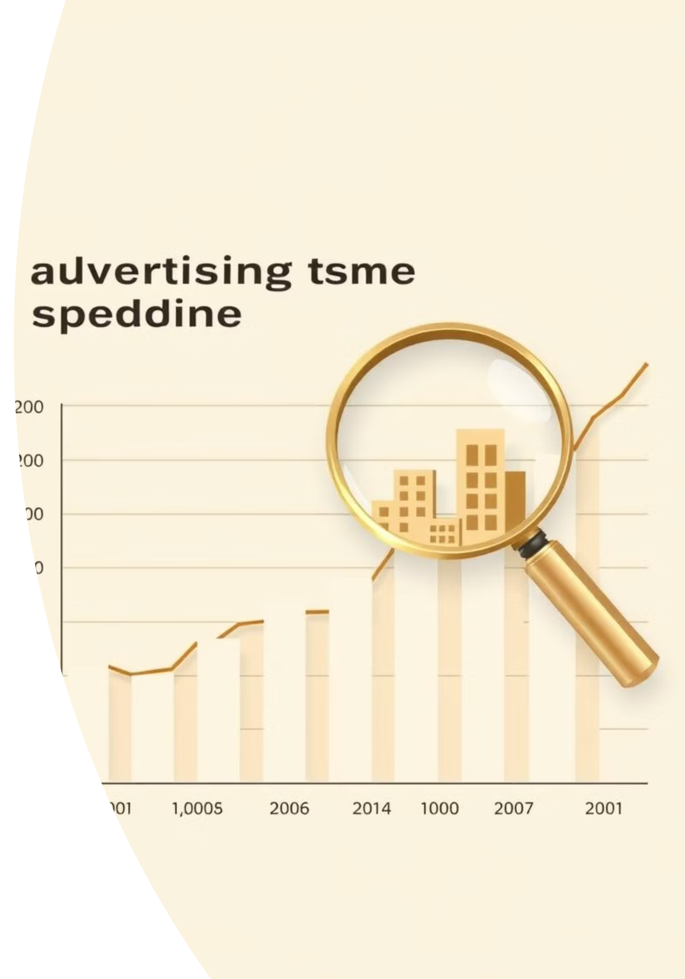
INITIAL DISCOVERIES
Unpacking Key Business Insights
Circulation Pressure Points
Evolving Ad Revenue Landscape
Identifying the largest month-over-month declines in print circulation is crucial for pinpointing markets under significant pressure. Our analysis reveals that Varanasi and Jaipur experienced the most significant single-month drops, highlighting an urgent need for digital intervention in these regions.
Our ad revenue analysis shows a clear market shift. While Government advertisements were dominant from 2019-2020, Real Estate has emerged as the top contributor since 2021. This shift indicates a resilient and growing sector, offering new avenues for targeted digital advertising strategies.

Slide 5
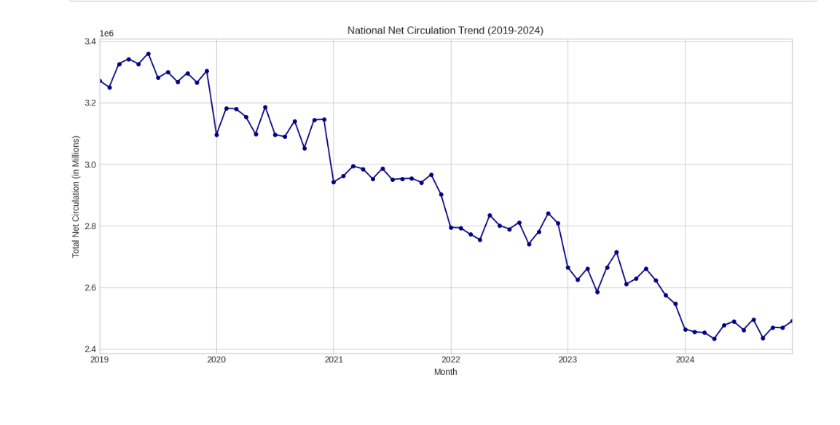
VISUALIZING THE SHIFT
National Print Circulation in Steady Decline
The data reinforces a consistent trend: national print circulation has been on a continuous downward trajectory from 2019 to 2024. This steady decline underscores the urgency and necessity of a robust digital transformation strategy to secure our future.

Slide 6
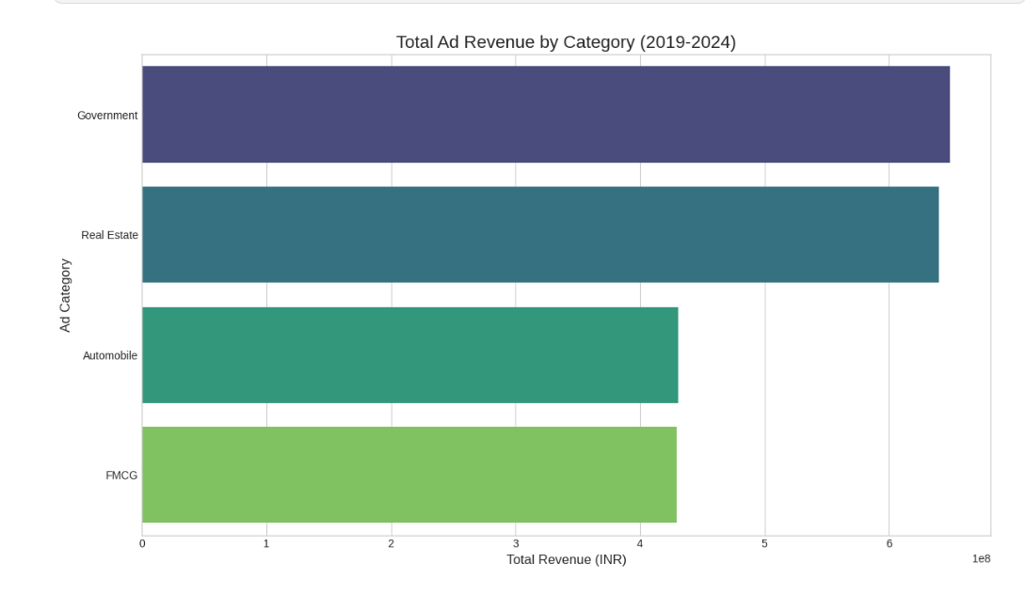
REVENUE DRIVERS
Real Estate and Government Ads Dominate Revenue
Our advertising revenue is heavily reliant on two key sectors: Real Estate and Government. These categories consistently represent our largest sources of advertising income, making them critical pillars of our financial health. Understanding and nurturing these relationships, especially in the digital space, is paramount.

Slide 7




ADVANCED ANALYTICS
Segmenting Cities by Digital Readiness with Machine Learning
Utilizing K-Means clustering, we've successfully segmented our operating cities into three distinct tiers based on their internet and smartphone penetration. This granular segmentation provides a powerful framework for developing targeted digital strategies tailored to each city's unique digital landscape.
Tier 1 (High Readiness)
Ahmedabad, Kanpur, Varanasi Ideal for aggressive digital expansion.
Tier 2 (Medium Readiness)
Delhi, Mumbai Ripe for focused digital investment and growth.
Tier 3 (Low Readiness)
Lucknow, Bhopal, Jaipur Requires foundational digital infrastructure development.

Slide 8
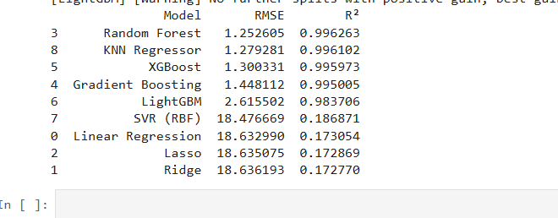

PREDICTIVE POWER
Forecasting Digital Adoption with Precision
Beyond segmentation, we've harnessed machine learning to predict internet penetration. After testing multiple models, the Random Forest algorithm emerged as the most accurate, boasting an impressive R² of 0.996. This predictive capability empowers us to proactively forecast digital readiness in new or data-sparse markets, guiding future expansion with unparalleled confidence.
Model Accuracy:
The Random Forest model's high R² value signifies its exceptional ability to explain the variance in internet penetration, making it a reliable tool for strategic planning.
This predictive tool can be invaluable for identifying emerging digital hubs and optimizing resource allocation for our digital transformation.

Slide 9

ACTIONABLE BLUEPRINT
Strategic Recommendations for a Digital Future
01
02
Prioritize Digital Transformation in Tier 1 Cities
Optimize Print Operations for Efficiency
Focus marketing, app development, and content strategy on Ahmedabad, Kanpur, and Varanasi to maximize digital penetration and engagement.
Investigate high-efficiency print markets like Ranchi to understand best practices and evaluate faster digital transition for markets with sharp circulation drops like Varanasi.
03
04
Refine Advertising Strategy for High-Value Segments
Leverage Predictive Models for Expansion
Utilize our Random Forest model to forecast internet penetration, guiding future market entry and resource allocation decisions.
Strengthen relationships with the Real Estate and Government sectors and develop targeted digital advertising packages for these key contributors.

Slide 10

LOOKING FORWARD
Conclusion & Next Steps: Charting Our Digital Course
Conclusion:
Next Steps:
The data provides a clear and actionable path forward. By strategically focusing our digital efforts on high-readiness markets while optimizing our legacy print business, we can not only navigate the industry's evolving challenges but also build a resilient and sustainable future for our newspaper in the digital age.
Develop tailored action plans for each city segment (Tier 1, 2, 3).
Launch a targeted digital marketing campaign in Tier 1 cities within the next quarter.
Conduct a deep-dive analysis into the operational efficiency of our top-performing print centers to identify transferable insights.
Establish a cross-functional digital transformation task force to oversee implementation and monitor progress.

